Slide 1


Pose-Based Word Presence Prediction: A Framework for Indian Sign Language Processing
Rudra Sinha
Department of Computer Science and Engineering

Slide 2
Outline
Scarcity of ISL dataset
Data set preparation
Processing Videos
Pipeline for extraction
Data cleaning
Word presence detection
Pose view of word and sentence
Approach
Cosine similarity
Dynamic Time warping
Result
Credits/Citations

Slide 3
Scarcity of ISL dataset
As per the WHO estimate, about 63 million people belong to the Deaf and Hard of Hearing (DHH) community in India (WHO, 2016; Varshney, 2016).
Sign languages are not universal—Indian Sign Language (ISL) has its own unique grammar, vocabulary and cultural context that differ substantially from, say, ASL or DGS sign systems.
According to the Government of India organization Indian Sign Language Research and Training Center (ISLRTC) (https://islrtc.nic.in/), there are only 300 certified sign language interpreters in India. NLP technologies can help in this case.

Slide 4
Dataset Extraction
The dataset was extracted from ISH News youtube channel.
Around 220k clips to transcript mapping
The transcript is an entire sentence in the range of 10-20 words, average length of a video is 7-8 sec with around 25 frames/sec.
The video was downloaded using yt_dlp, transcript was extracted using YoutubeTranscriptApi and the audio was extracted using ffmpeg.

Slide 5
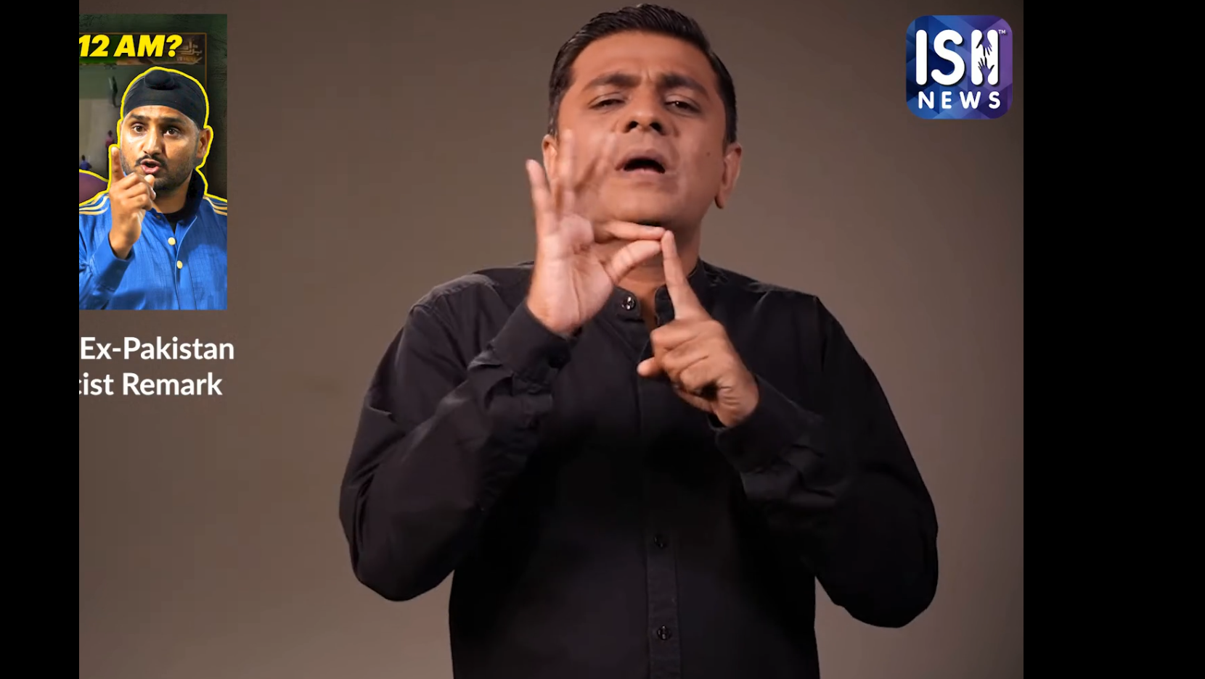
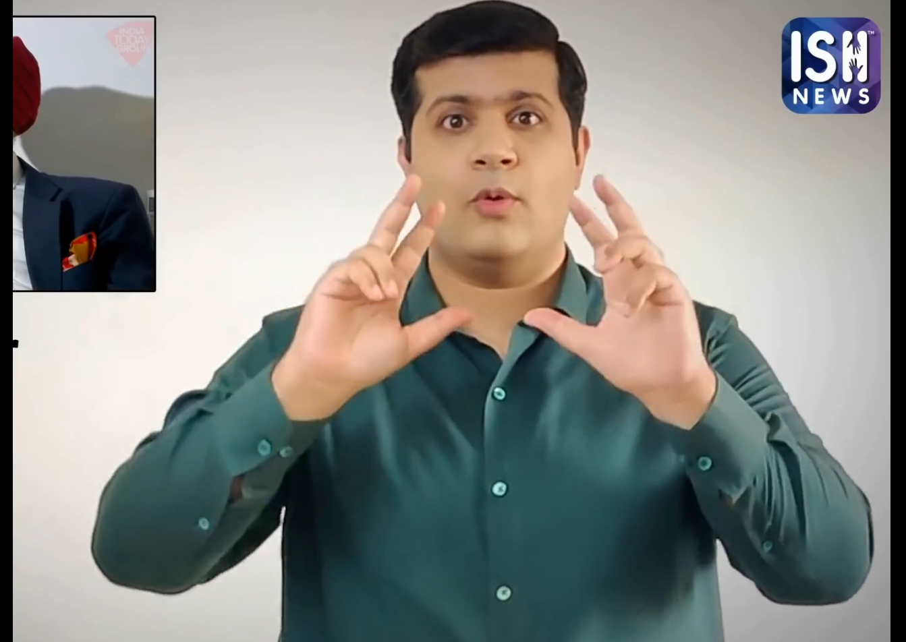
Processing Videos
The video is clipped according to the timestamps of the transcript.
The video is then cropped according to the region of interest (area where the person is doing sign languages)
The video was extracted playlist-wise and each playlist had similar ROI

Slide 6
Pipeline for Extraction
Load Video data
If ( Transcript or Voice-over present)
Move to next video if false
Create Clip Folder in source directory
Clip ,Crop ,mute and store sub-clip
Write transcript in a .txt file
Extract audio and store as .mp3

Slide 7
Data Cleaning
In some videos the ROI selected was improper , i.e, the signer’s hand was getting out of frame or he/she was not present at all. Those videos were manually checked and removed from the dataset.
Some videos from which ffmpeg couldn’t extract audio but they have a transcript was saved separately.
If a video didn’t have any transcript , the auto-generated transcript is not used as it is very out-of-sync hence the clip-to-transcript mappings would be gibberish. For such videos only the audio is extracted(if present) and the video-audio pair is saved separately. Then we could easily run ASR model to get the text.

Slide 8
Future Plans
Made a script to extract latest data for ISH not present in the dataset.
The script prompts the user for the date from which the user would want to extract.
Since ISH is a news channel each large playlist of it has a predefined template which it follows.
If the template has changed , the script has an option to prompt the user to select the ROI manually by giving a frame for the video.

Slide 9
Word Presence Detection
Problem statement:
Given a query word and a sentence, need to find out whether the signer performs the sign language of the word in the sentence.
Objective:
This task serves as a benchmark to validate the quality and consistency of the constructed sign language dataset.

Slide 10
Word Presence Detection
Used only 5.4k videos as candidate sentences due to limited resources and time.
For the words used the CISLR dataset
Extracted pose landmarks of both using mediapipe

Slide 11
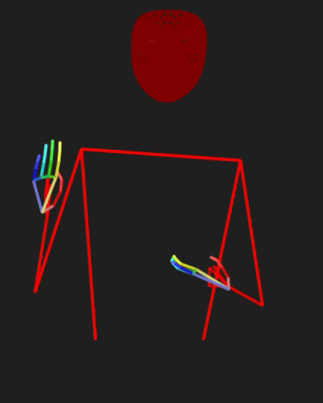
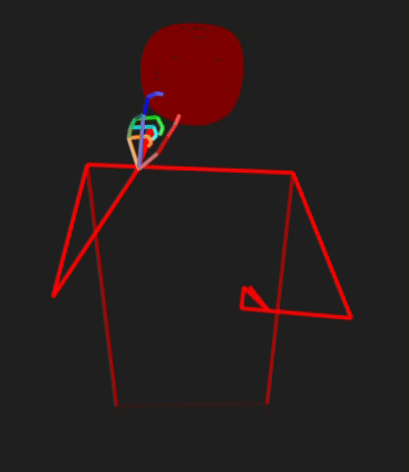
Pose view of Candidate Sentence
Pose view of query word

Slide 12
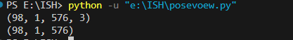
.pose file structure
Contains data in binary
Pose.data = [frame,person,landmarks,coordinates] , coordinates = [x,y,z]
Pose.confidence = [frame,person,landmarks,confidence]
There are 576 landmarks per frame
Ex:

Slide 13
Approach
Used only arm ,shoulder and arm landmark as using the body and face landmarks were giving unnecessary similarity/dissimilarity.
Normalized the used landmarks according to the average of hip coordinates across all frames to remove the effect of different spatial position of the signer.
There is still a issue of variable torso length, arm length, etc. but they have been ignored for the sake of simplicity.
Two primary methods are used for measuring similarity- Cosine Similarity and Dynamic Time Warping(DTW)

Slide 14
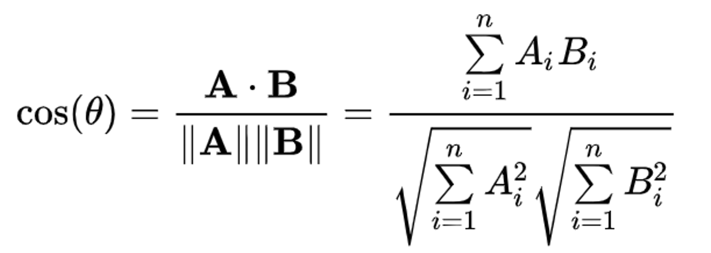
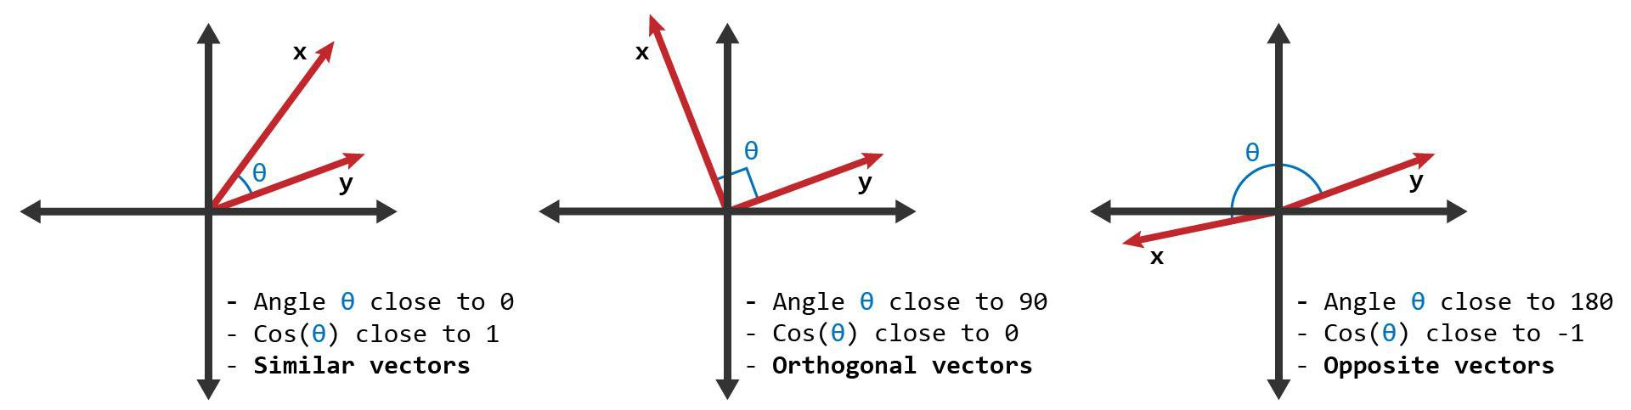
Cosine Similarity
Each landmarks has 3 coordinates per frame.
Used Scipy library to calculate Cosine Distance.
Cosine Similarity = 1 – Cosine Distance

Slide 15
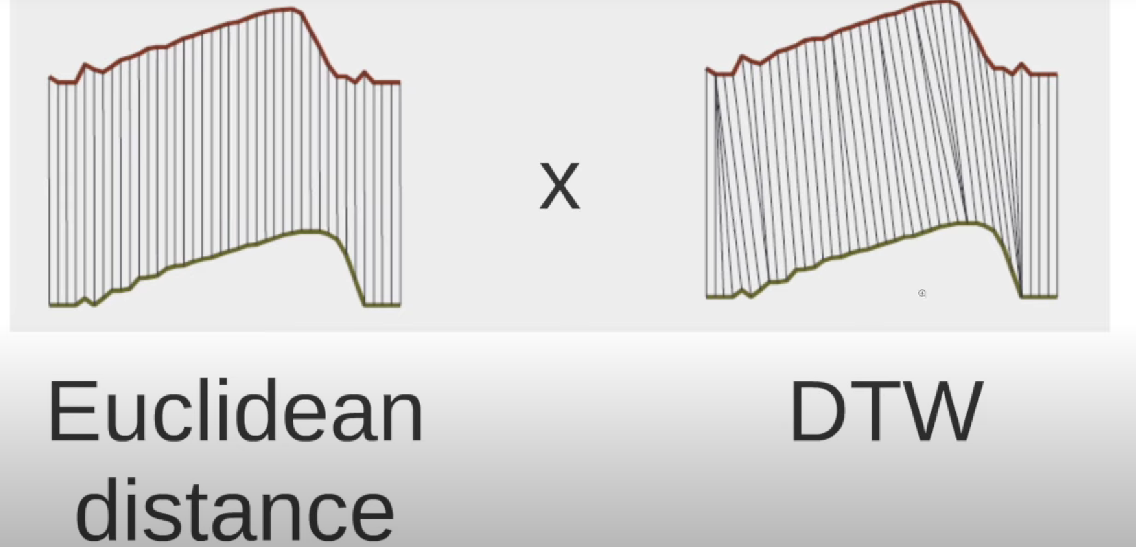
Dynamic Time Warping

Slide 16
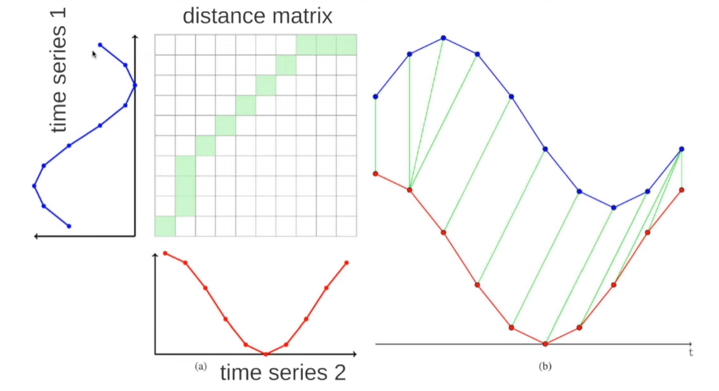

Slide 17
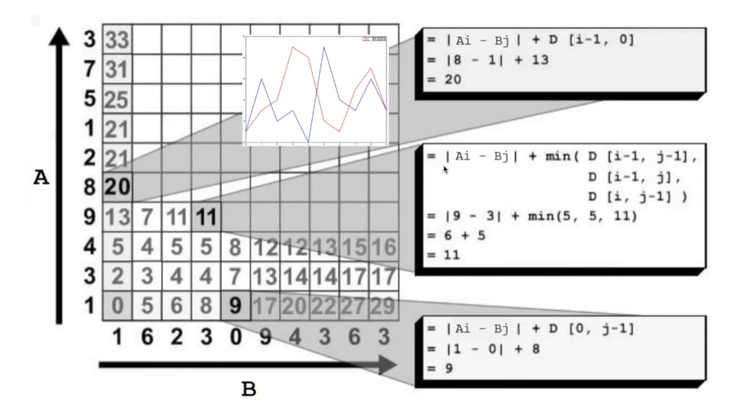

Slide 18
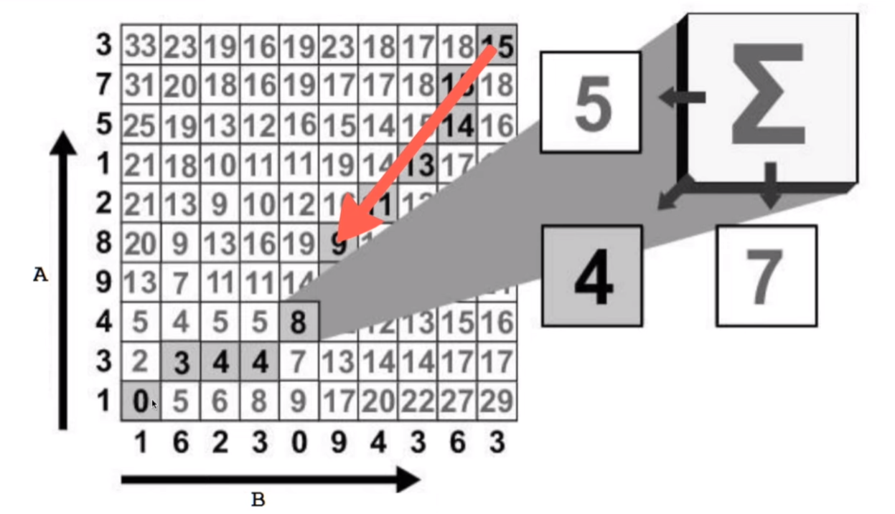

Slide 19
Approach( Continued)
Trimmed the word video from start and end to remove static frames.
Used sliding window technique to find out the best match (highest score) across all frames of the sentence between (0,sentence_frames-word_frames)
After getting similarity of a landmark in a frame, multiplied it by the confidence factor and took the average of the similarity of all the landmarks used to get similarity of a frame.
Threshold for DTW = 0.07 (if score is less than this then word is present)
Threshold for Cosine Similarity = 0.41 ( if score is more than this then word is present)

Slide 20
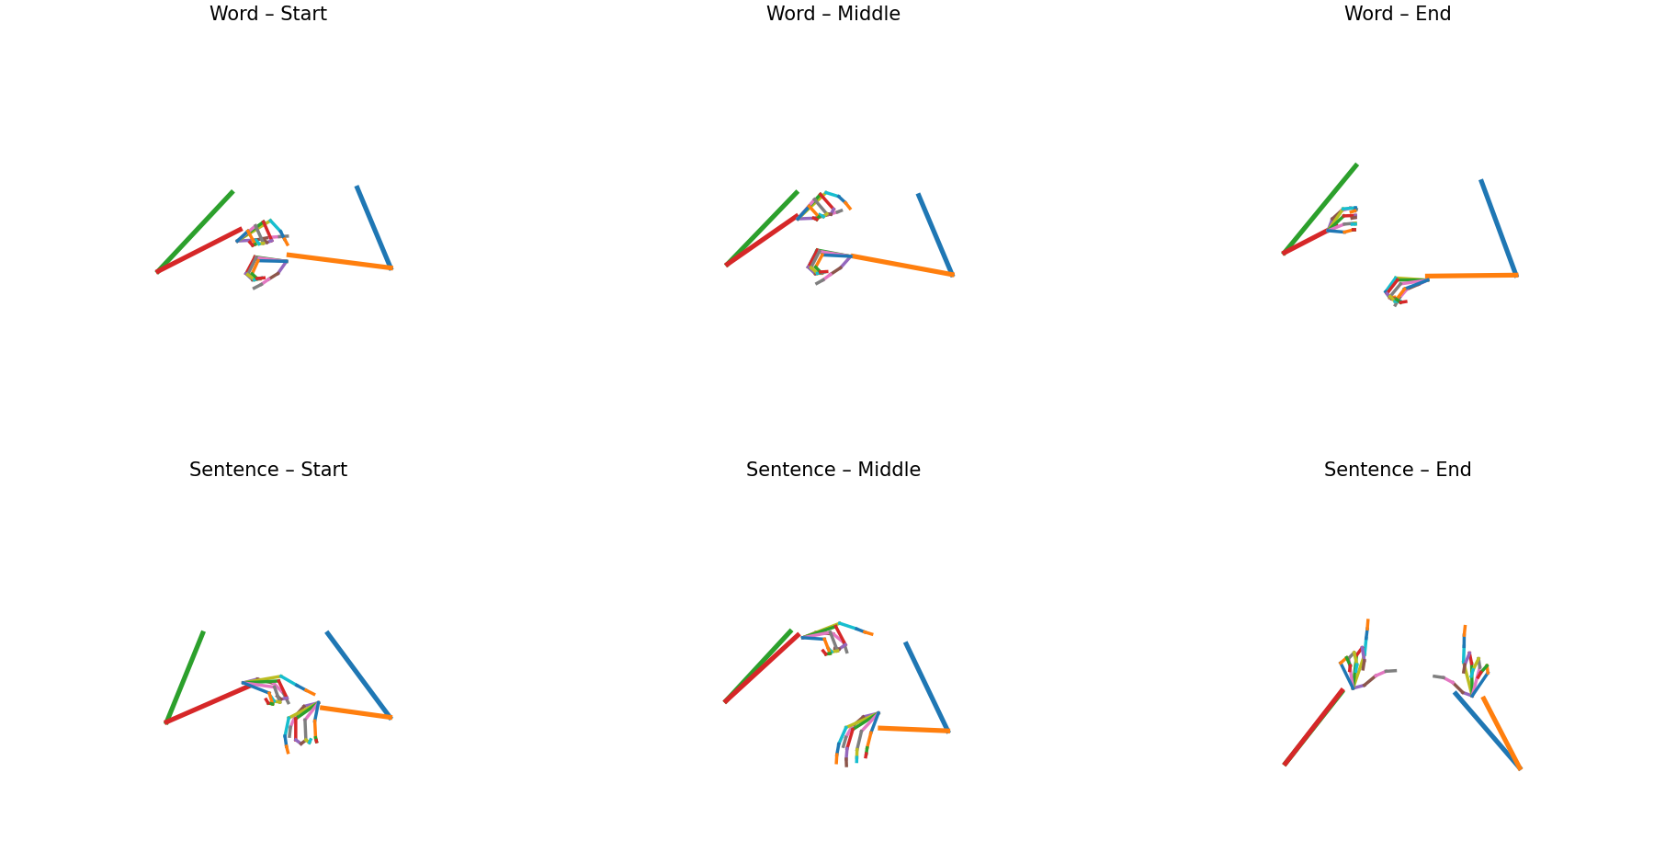
Word = Time
Sentence = Haryana native Neeraj Chopra participated in the Javelin throw in the 2020 Tokyo Olympics for the very first time.

Slide 21
Top(5/10/15/20) Result
Due to time and resource constraint used 100 words to 100 sentences matching (about 10^4 different pairs)
COSINE DTW
Unique Pair Evaluation (100 pairs): Unique Pair Evaluation (100 pairs):
Top-5 : 25.00% (25/100) Top-5 : 29.00% (29/100)
Top-10 : 36.00% (36/100) Top-10 : 34.00% (34/100)
Top-15 : 39.00% (39/100) Top-15 : 44.00% (44/100)
Top-20 : 46.00% (46/100) Top-20 : 52.00% (52/100)

Slide 22
Credits/Citations
A big THANK YOU to Sanjeet for guiding me through my UGP journey and Prof. Ashutosh Modi for proving me the opportunity to work on this task.
Media Pipe (https://github.com/google-ai-edge/mediapipe)
I-Sign and CISLR paper (https://exploration-lab.github.io/iSign/) , (https://aclanthology.org/2022.emnlp-main.707/)
ISH news channel (https://www.youtube.com/@ISHNews)
Pose viewer (https://github.com/bipinkrish/vscode-pose)
DTW (https://www.youtube.com/@tkorting)

Slide 23
THANK YOU

